Slide 1

Diagnosis ML
Chris Burley, Brandon Lee, Vik Shah, Navid Motlagh, Tu Cam Dang

Slide 2
Agenda
Project Background & Objective – Tu Cam
Project Scoping – Navid
Extract Transform Load & Cleaning Data – Vik
Machine Learning Modelling – Chris
Machine Learning Predictions – Brandon

Slide 3

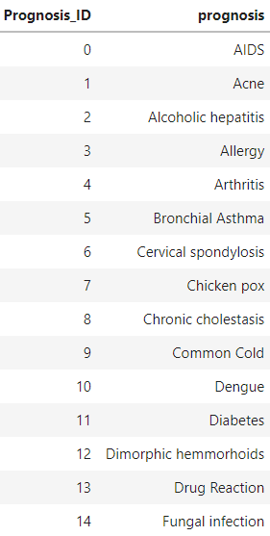
Background
Background: 21st Century human nature is to google everything. As a result, self-prognosis is more common. The market has created itself and this tool will meet demand needs.
Objective: machine learning to predict a patient’s ailment based on 132 symptoms i.e., variables.

Slide 4

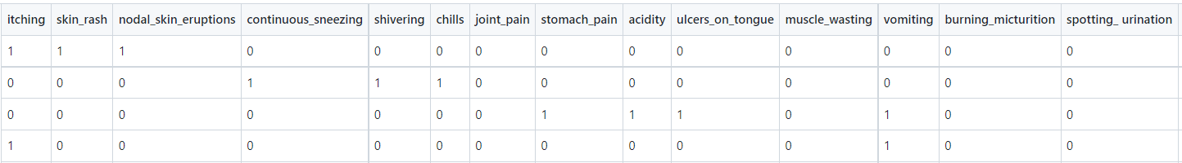
Scoping
Identified sample dataset from Kaggle, listing 132 symptoms with 41 unique prognoses
Test dataset (42 records) & Train dataset (4920 records) were used
Dataset illustrates symptoms in binary form i.e., 1 = yes and 0 = no
Prior medical knowledge is recommended to ensure appropriate interpretation of the symptoms
Future scoping may include more comprehensive details and descriptions for each symptoms e.g., using tooltips

Slide 5

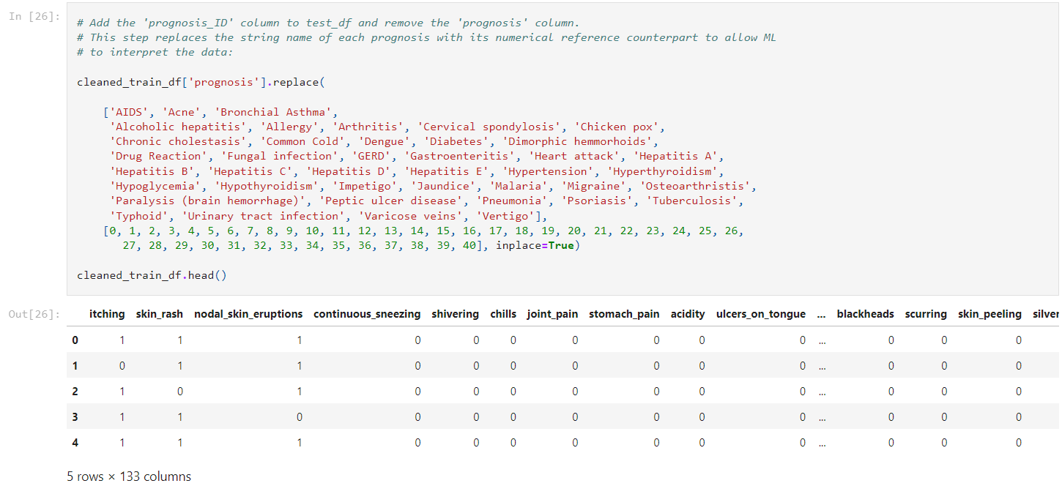
Extract Transform Load
Extract from kaggle,
Import csv
Transform dataset,
Delete blank column
Rename columns to simply and normalize
Replace similar data to uniform
Delete null rows
Load dataframe,
Cleaned_train_df

Slide 6

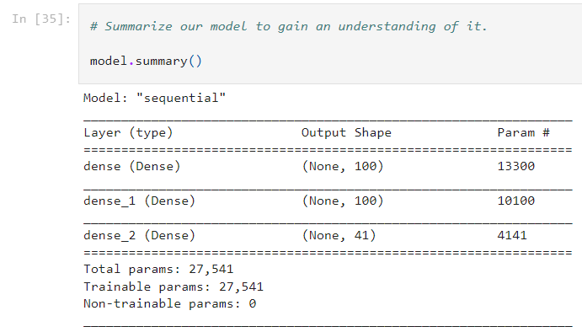
Modelling

Slide 7

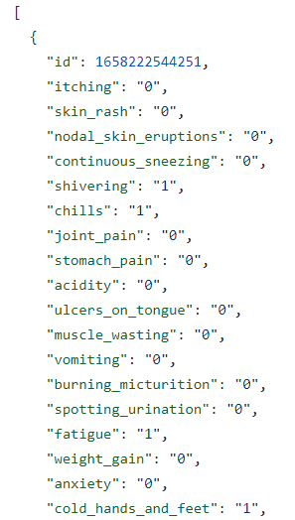
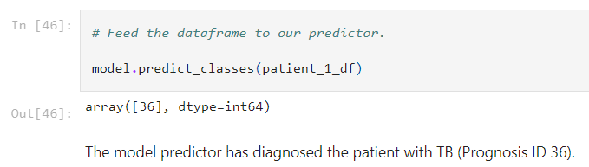

Predictions
Patient/ Doctor inputs symptoms in form and ML predicts prognosis

Slide 8
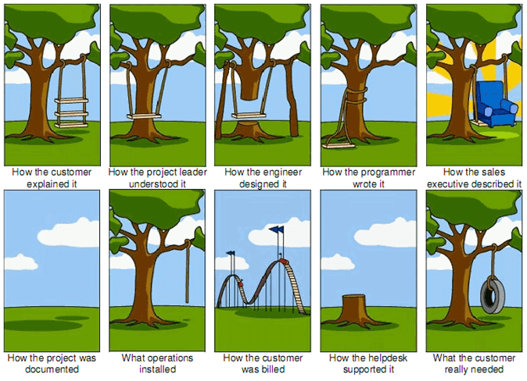
Questions

